Slide 1
Peripheral & Interfacing Lab CSE 316
Name: Ayman Hasib
Registration no: 18201065
Section: B1

Slide 2
My Task Title
Geometrical Shapes Design by LED

Slide 3
Task Description
In this individual task there will be some LED lights, which will be connected with the Arduino board. Those LED lights will connect with each other so that when the user press the switch it will continuously blink until turning off the switch.
Those lights are connected with a format so that they create a geometrical shape like Rectangle and Triangle.
All these function will be added to a single Arduino board and will be controlled by two different switch's.

Slide 4
Components for this task
Arduino UNO board
Switch’s
LED Light
Resistors
Grounds
Power
Proteus Software & Arduino IDE

Slide 5
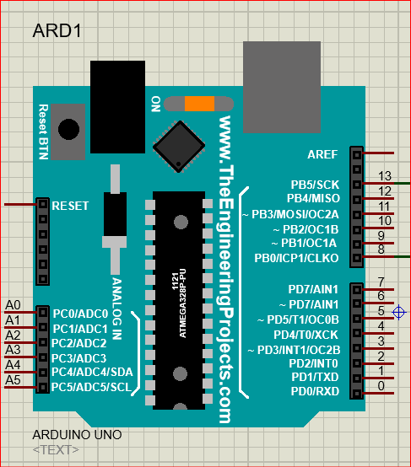
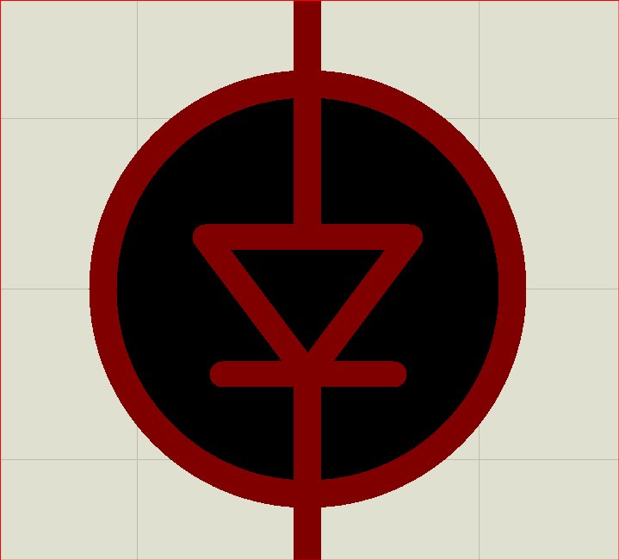
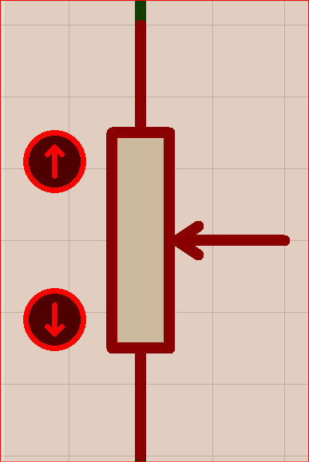
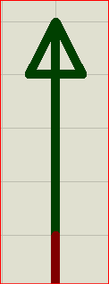
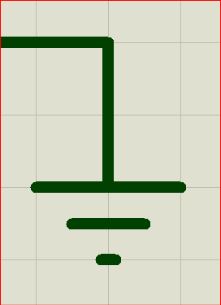
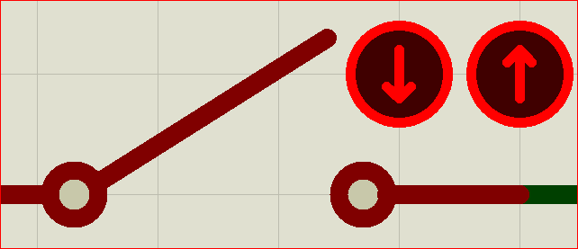
Components Picture
Arduino UNO
LED
Register
Power
Switch
Ground

Slide 6

Feel free to ask-
if you have any query.

